Slide 1

Healthcare Performance Dashboard
Patient, Clinical, Doctor Performance & Financial Analytics
Presented by: Anurag Kumar Poddar
Role: Data Analyst / Business Analyst
Project Type: Microsoft Power BI Portfolio Project

Slide 2

Project Overview
What is this project?
An interactive Microsoft Power BI dashboard designed for healthcare analytics.
It provides a single, consolidated view of patient activity, clinical patterns, doctor performance, billing, and insurance data.
Key Purpose:
Converts raw patient-level data into a visual management tool.
Helps users identify patterns, compare performance, and support data-driven decisions.
Design:
A single-page report with interactive filtering.
Users can explore data by patient and admission date range.

Slide 3

Business Problem & Purpose
The Problem:
Healthcare data contains vast information (admissions, diagnoses, billing, etc.).
Reviewing raw tables makes it difficult to quickly identify important patterns or trends.
The Solution:
A visual analytics layer that helps users:
  -Monitor key patient and financial indicators from one dashboard.
  -Understand patient distribution across bed categories.
  -Compare doctor-level revenue, insurance, and feedback.
  -Identify high-volume diagnoses and compare billed vs. insured amounts.

Slide 4

Project Objectives
Main Goals:
- Build an interactive healthcare analytics dashboard using Power BI.
- Transform patient-level data into clear KPIs and business-friendly visualizations.
- Provide visibility into patient activity and important dates.
- Analyze diagnosis and bed-category distribution.
- Evaluate doctor-level operational, feedback, and financial performance.
- Compare billing and health insurance amounts by diagnostic test.
- Create a portfolio-quality dashboard demonstrating practical Power BI skills.

Slide 5

Data & Preparation Approach
Data Used:
A structured patient-level healthcare dataset.
Key fields include: Patient_ID, Admit_Date, Discharge_Date, Diagnosis, Test, Bed_Occupancy, Doctor, Feedback, Billing Amount, and Health Insurance Amount.
Power BI Workflow:
Imported & Structured: Loaded the healthcare dataset into Power BI.
Aggregated: Used count, sum, and average based on the business question.
Configured Slicers: Added interactive filters for Patient_ID and Admit_Date.
Styled: Applied sorting, titles, formatting, and visual styling for readability.

Slide 6
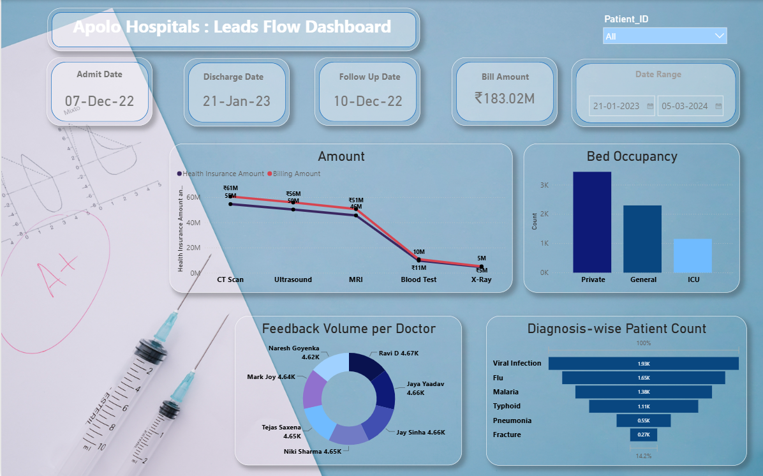
Dashboard KPI Layer
Quick-Reference KPIs (Top Section):
KPI | Calculation Logic | Business Meaning
Earliest Admission | Minimum Admit_Date | Shows the beginning of the selected admission period.
Latest Discharge | Minimum Discharge_Date | Provides a discharge-date reference for the report.
Follow-Up Scheduled | Minimum Followup Date | Provides visibility into follow-up scheduling.
Bill Amount | Sum of Billing Amount | Provides a consolidated billing value for the selected data.

Slide 7
Analytical Insights Enabled
The Dashboard Helps Answer:
Which bed category has the highest patient volume?
Which diagnoses represent the largest patient volumes?
Which doctors handle higher patient volumes?
How does doctor-level average feedback compare?
Which doctors generate higher billing amounts and how do insurance amounts compare?
Which diagnostic tests have higher billed amounts?
How do health insurance amounts compare with billed amounts?
How does the analysis change when a specific patient or date period is selected?

Slide 8
Project Outcomes & Tools
Key Outcomes:
Created a complete single-page healthcare performance dashboard.
Converted multiple healthcare fields into meaningful KPIs and visual analytics.
Enabled patient and date-based filtering for focused analysis.
Provided doctor-level financial and performance comparison.
Improved readability of raw healthcare data through visual storytelling.
Tools & Skills Demonstrated:
Microsoft Power BI
Data Visualization & Dashboard Design
KPI Development
Interactive Slicers & Filtering
Healthcare / Patient Analytics
Financial & Insurance Analysis

Slide 9

Conclusion & Future Scope
Conclusion:
This dashboard demonstrates how Power BI can convert healthcare data into a practical analytical solution.
It provides a clear way to explore patient activity, clinical patterns, doctor performance, and financial information.
The project reflects a business-oriented approach: understand the data, ask the right questions, and present results that support faster decision-making.
Future Enhancements:
Add a dedicated Date table for advanced time-intelligence.
Include admission-type, gender, age-group, and medication analysis.
Add calculated measures like average length of stay and revenue per patient.
Add conditional formatting for doctor performance benchmarks.
Add an executive summary page and detailed drill-through pages.

Slide 10

END OF PROJECT
Thank You

Slide 11

Thank you
Anurag Kumar Poddar
Data Analyst
+919748748405
anuragkumarpoddar@gmail.com

